Slide 1
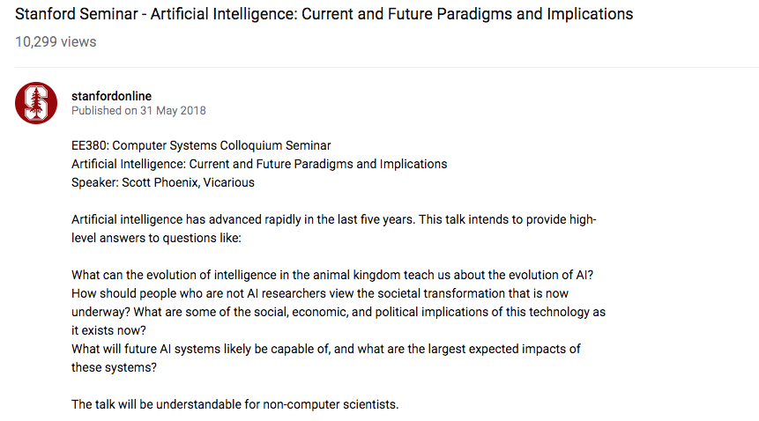
https://www.youtube.com/watch?v=wJqf17bZQsY&t=2155s

Slide 2
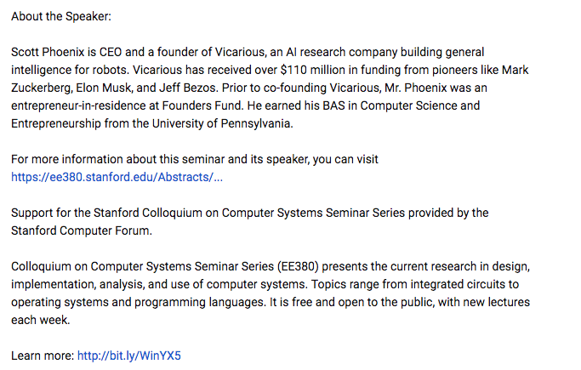

Slide 3
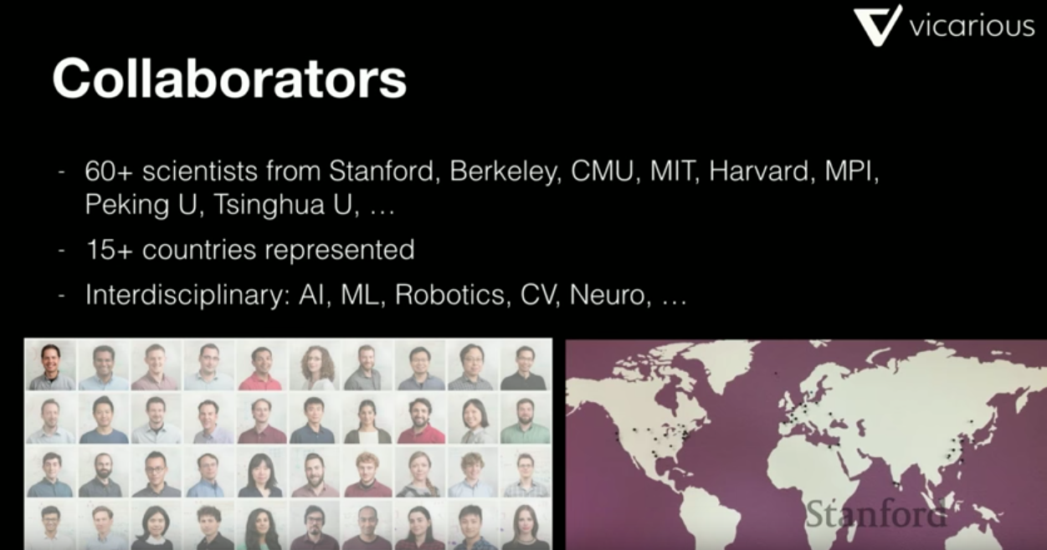

Slide 4
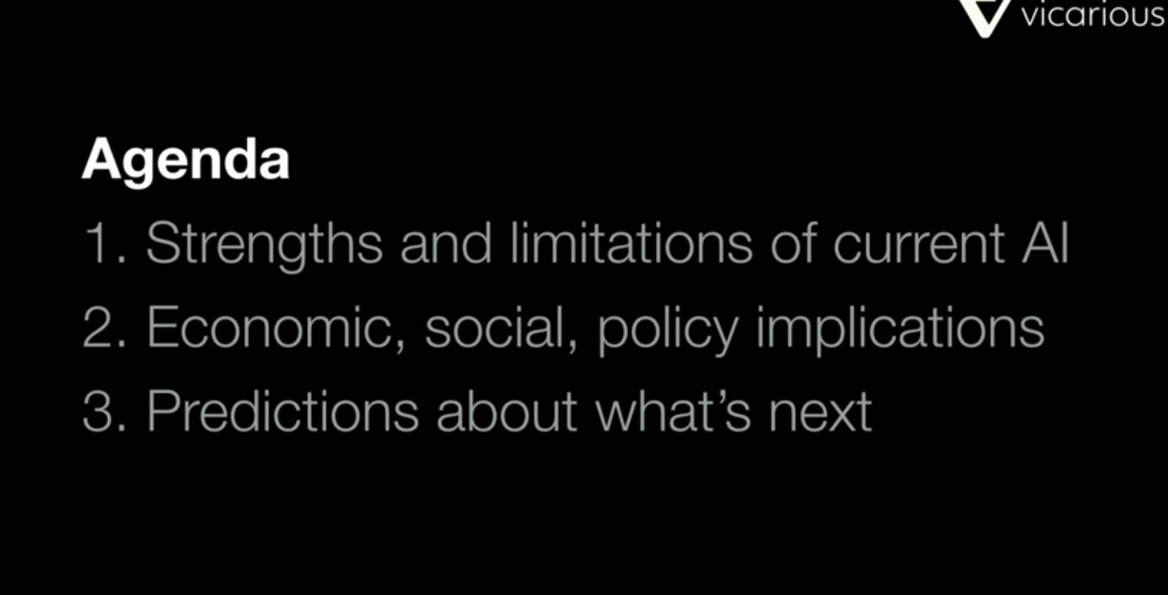

Slide 5
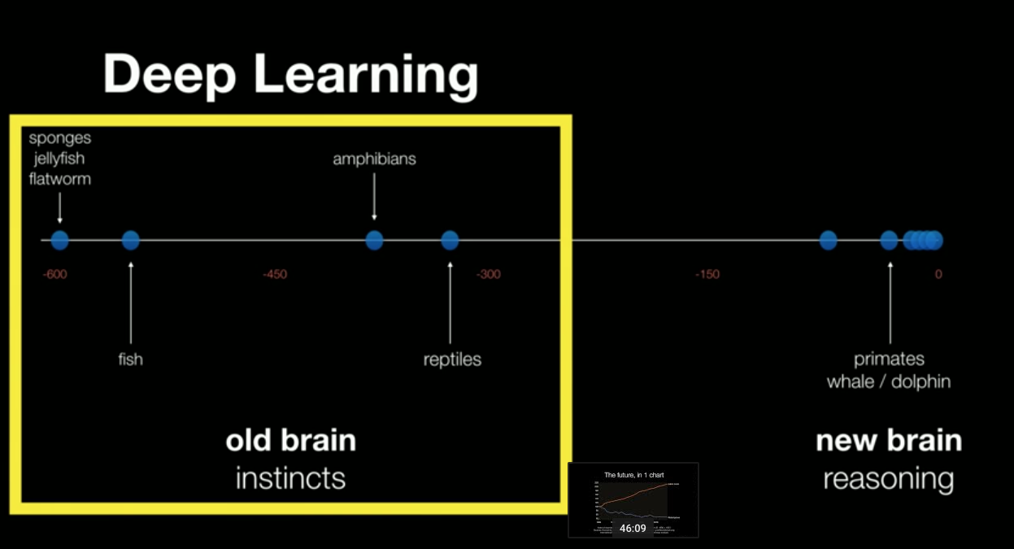

Slide 6
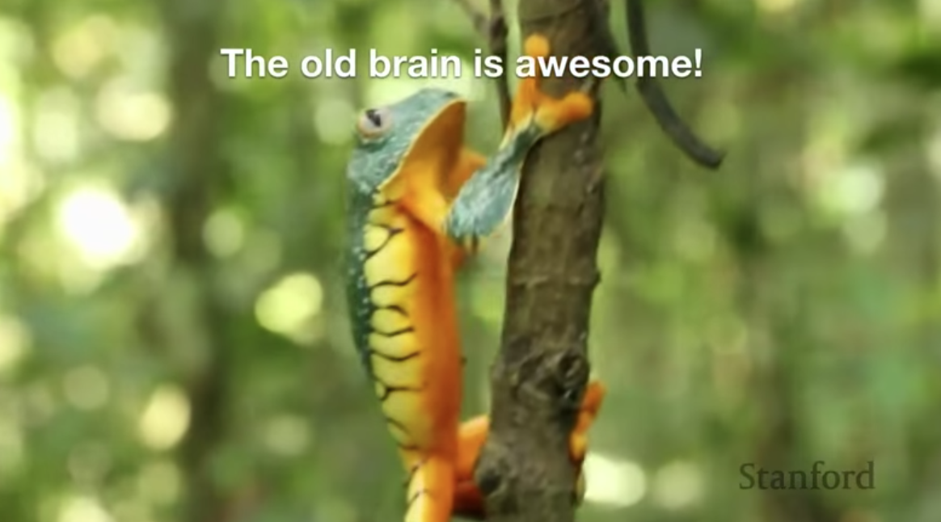

Slide 7
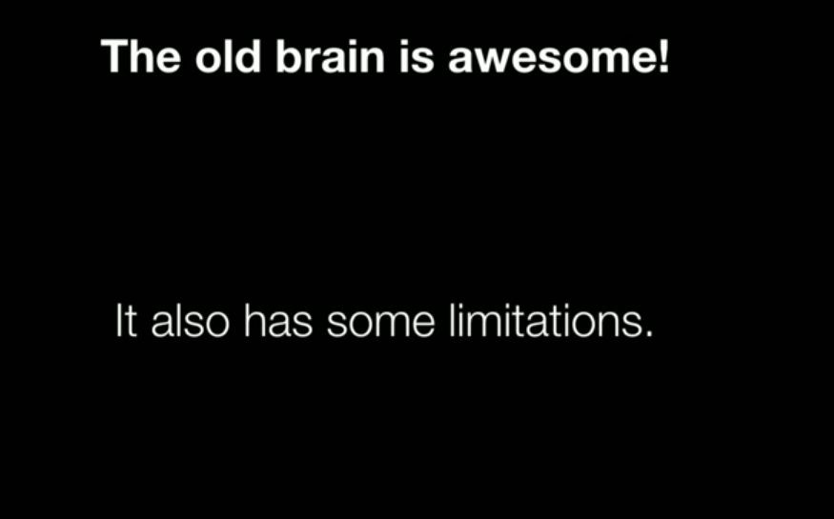

Slide 8
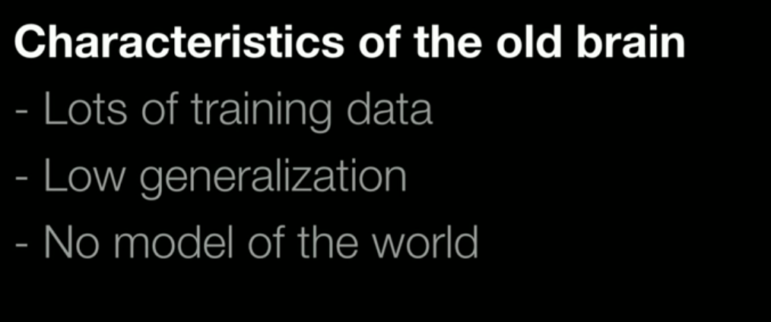
Took the all evolution data

Slide 9
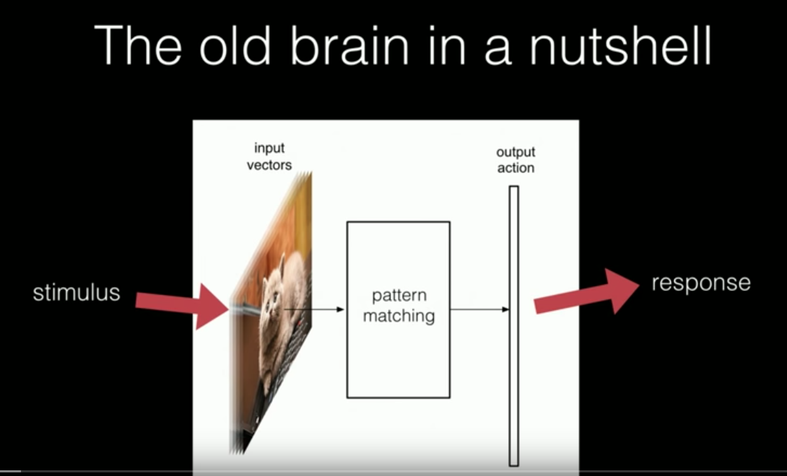

Slide 10
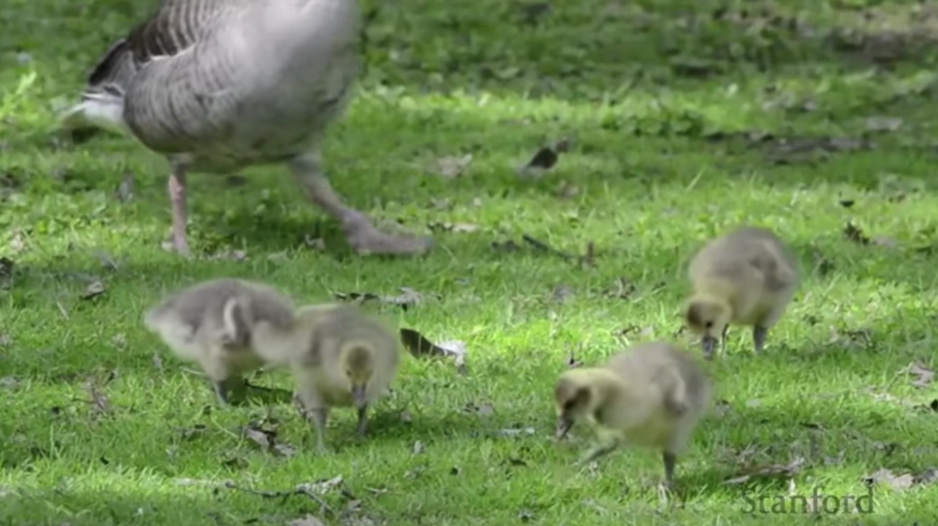
The mamy goose would take care of any poussing with that sounds

Slide 11
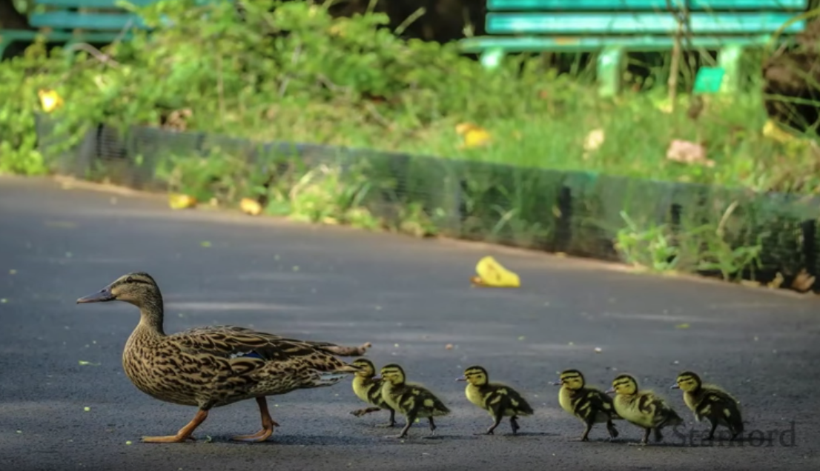
Baby ducks would follow any animal they first see. They would follow a dog

Slide 12
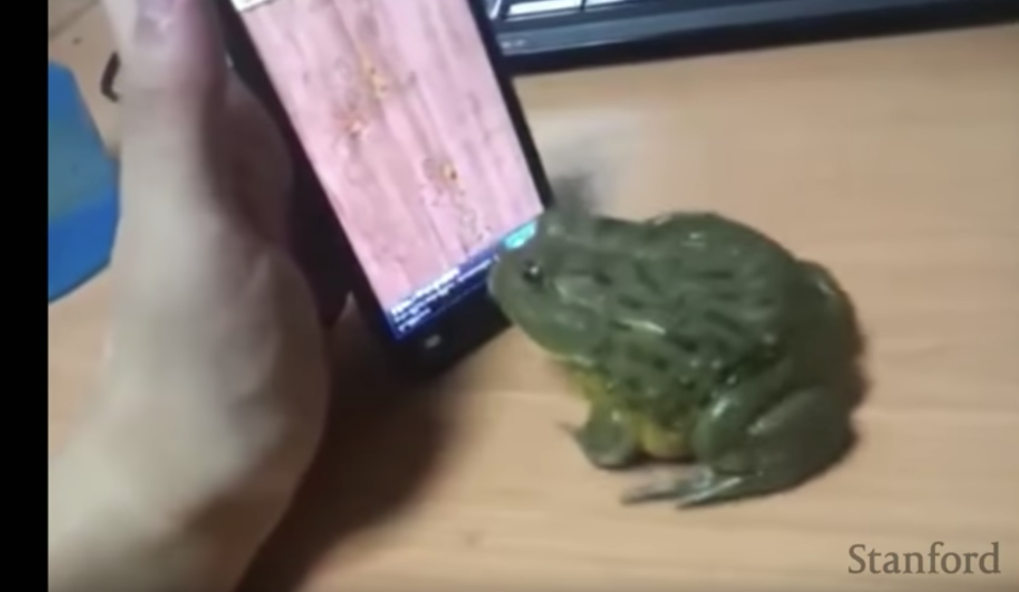

Slide 13
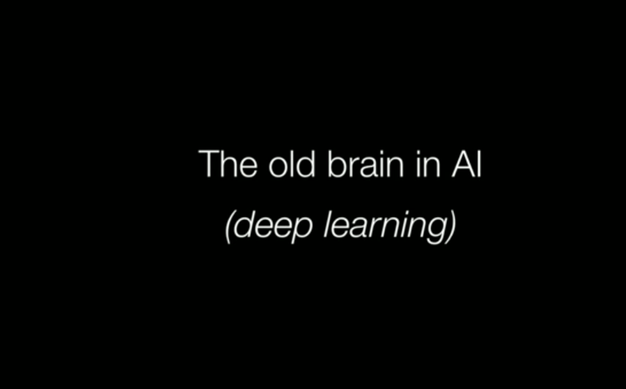

Slide 14
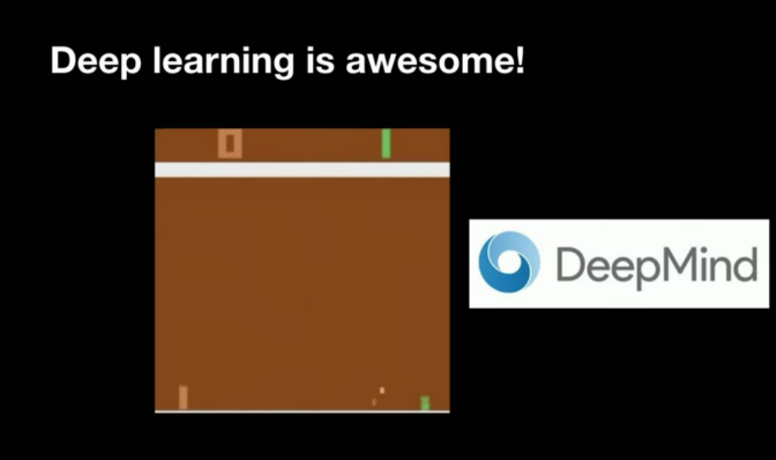

Slide 15
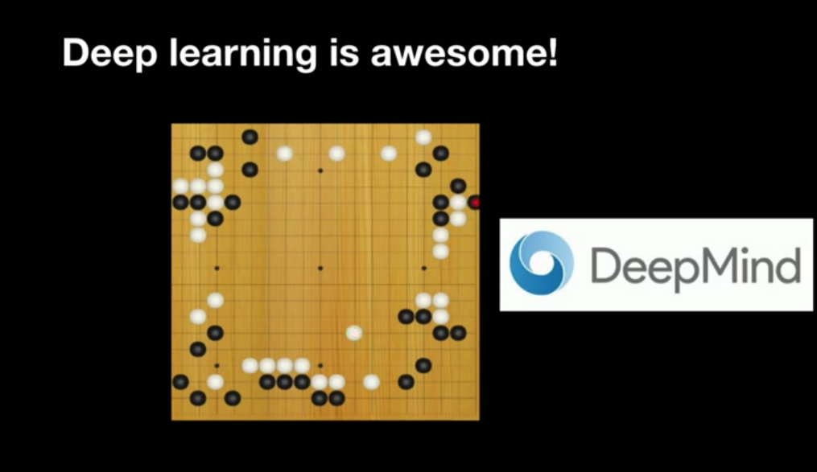

Slide 16
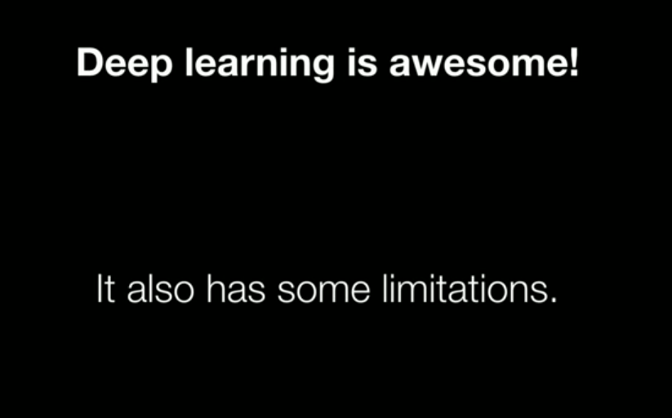

Slide 17
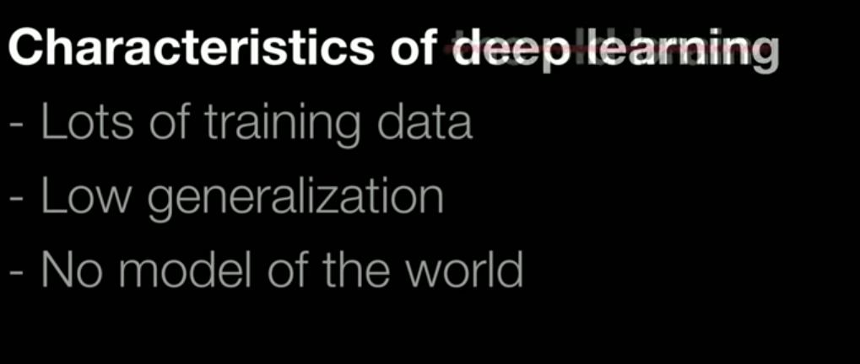
Same limitations of old brain. Do not understand cause and effect

Slide 18
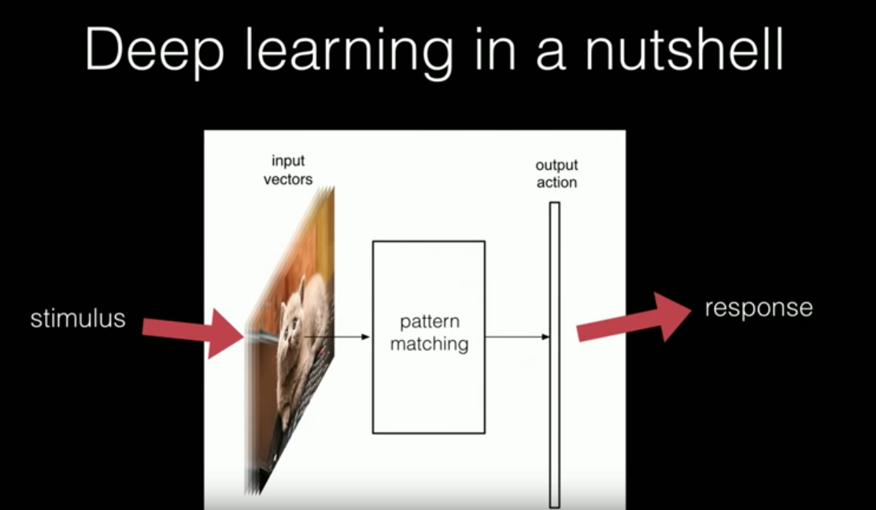

Slide 19
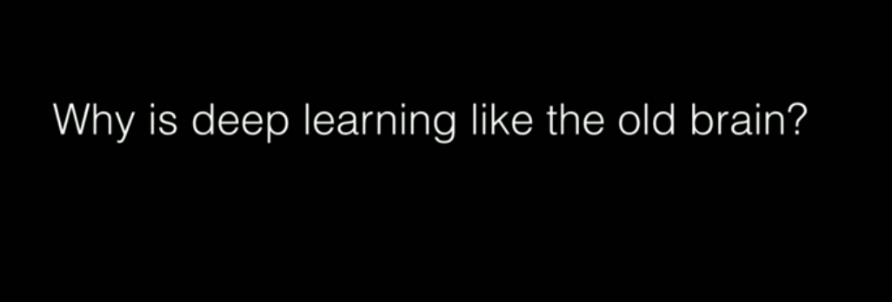

Slide 20
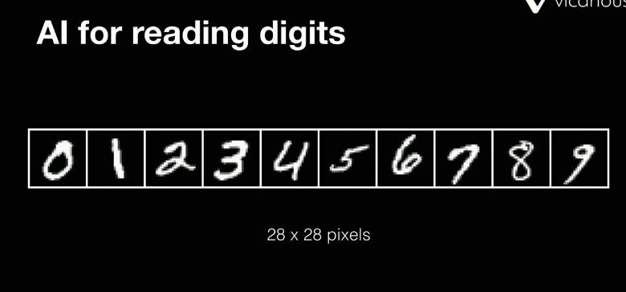
Let’s try to see how Alpha Go works

Slide 21
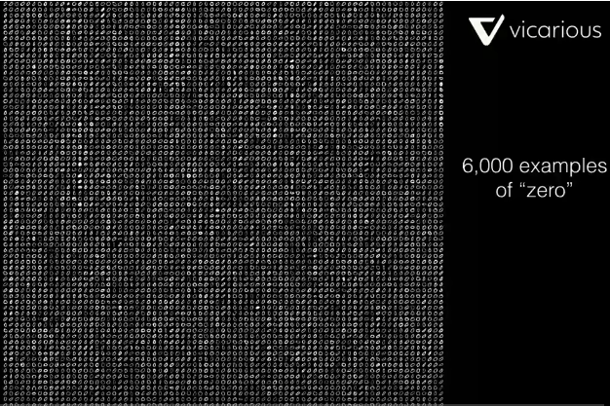

Slide 22
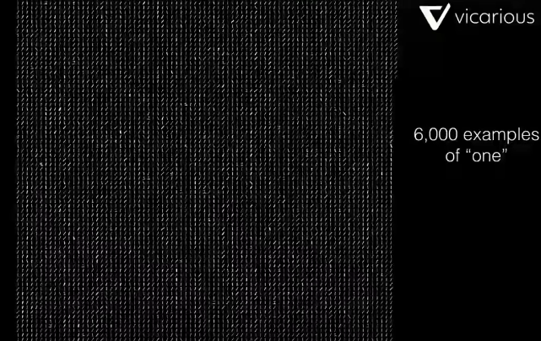

Slide 23
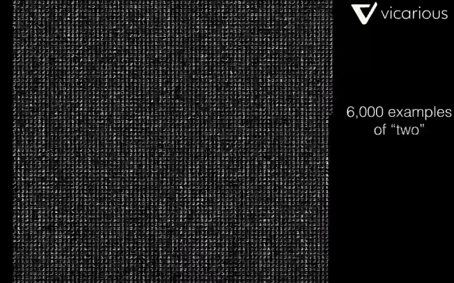

Slide 24
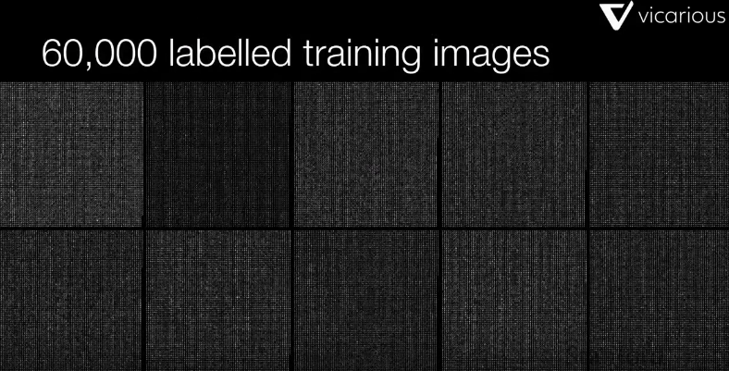

Slide 25
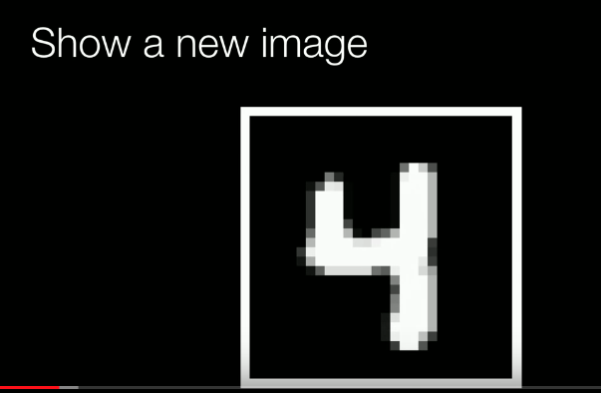

Slide 26
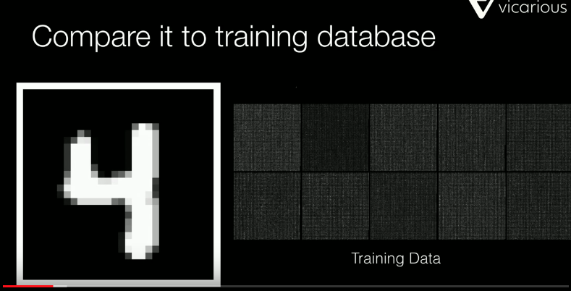

Slide 27
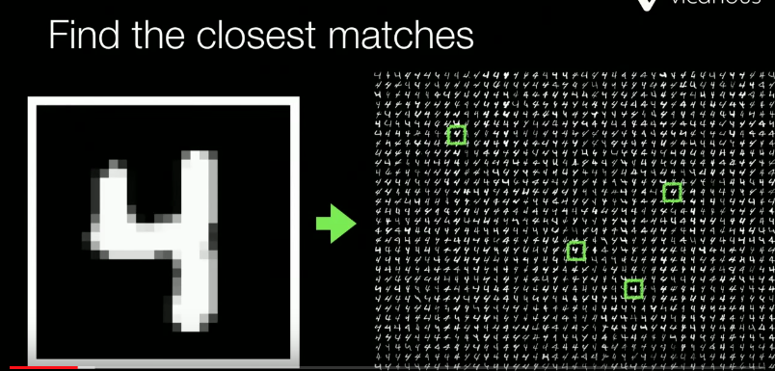

Slide 28
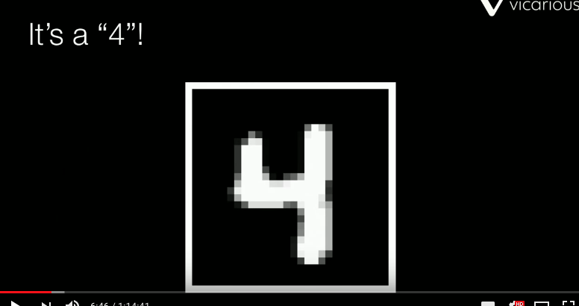

Slide 29
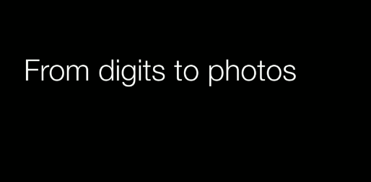

Slide 30
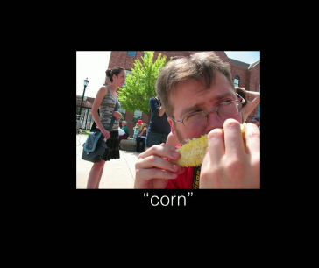
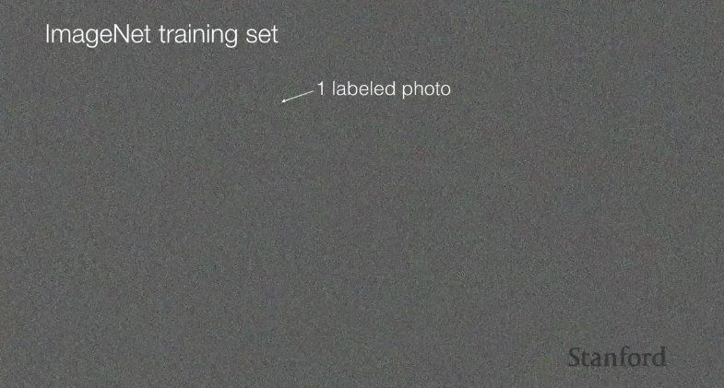

Slide 31
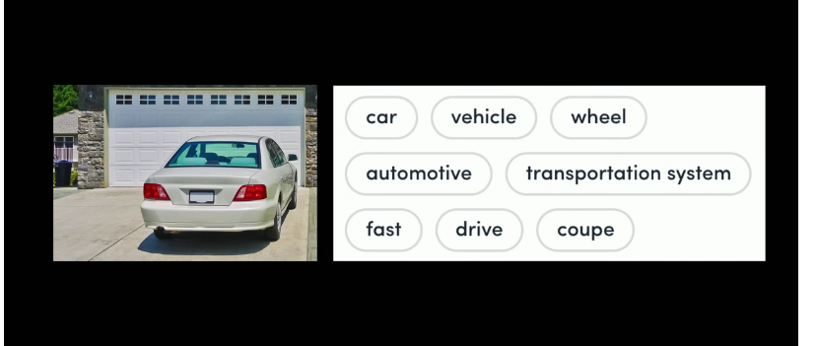

Slide 32
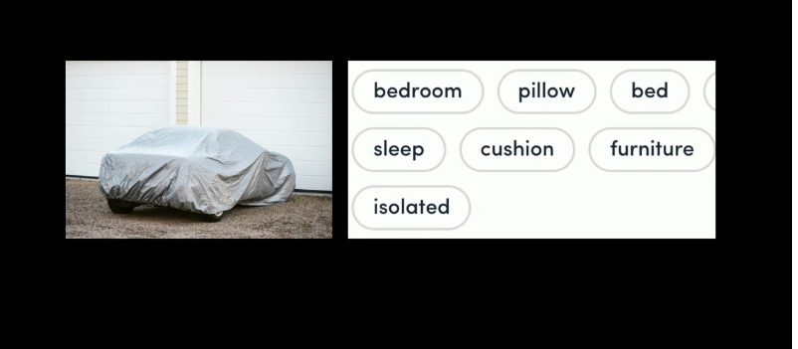
Bedroom pillow

Slide 33
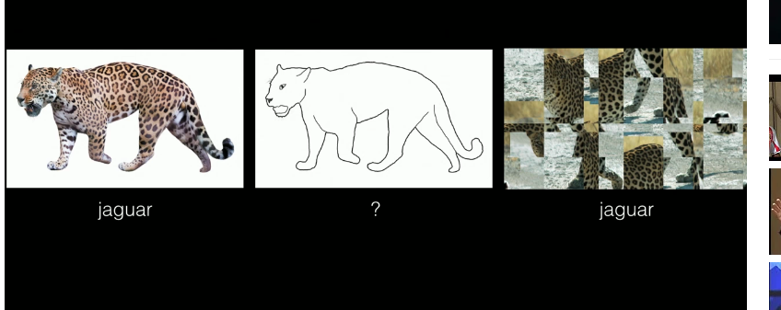
Would recognize the jaguar but handwritten one « no idea », last one would be recognized as
Jaguar as well

Slide 34
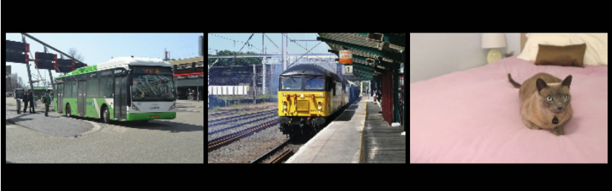
Just matchning patterns

Slide 35
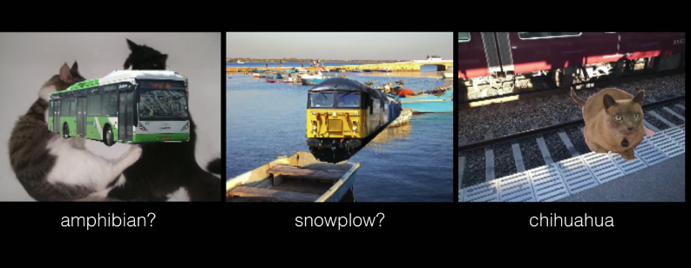

Slide 36
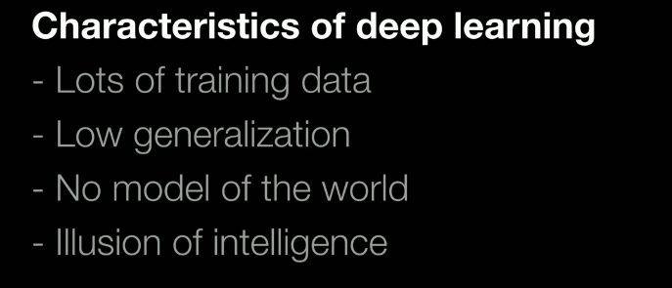

Slide 37
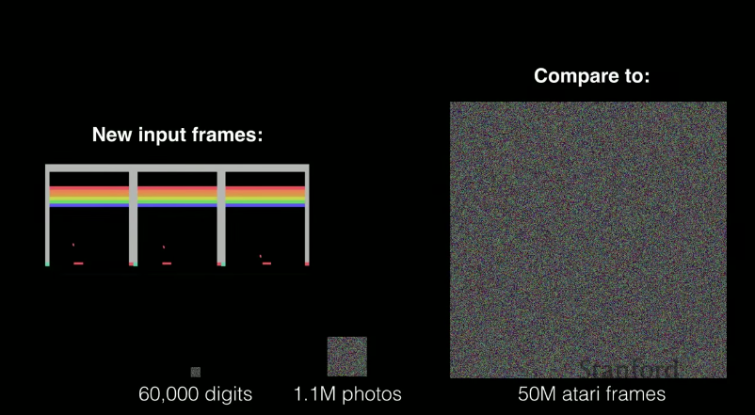

Slide 38
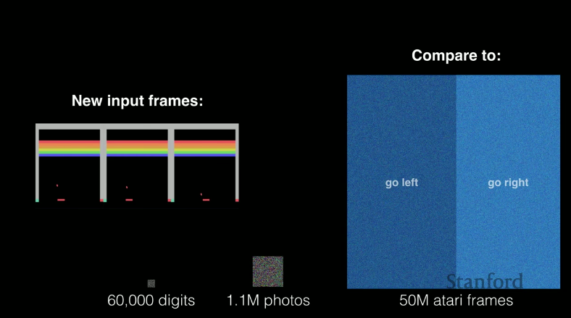

Slide 39
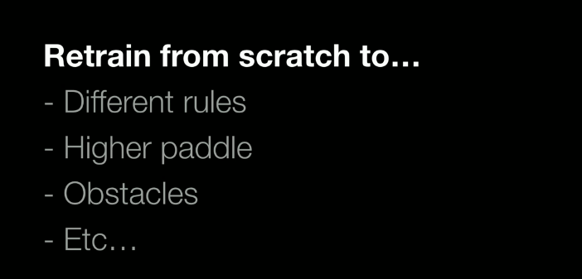

Slide 40
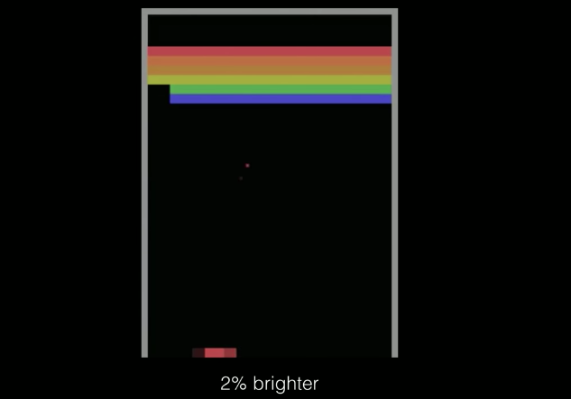
Get broken

Slide 41
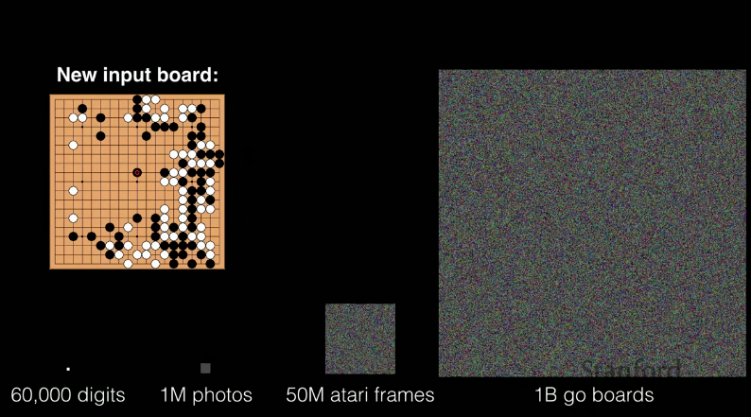
3 thousand years 24hours a day for a human

Slide 42
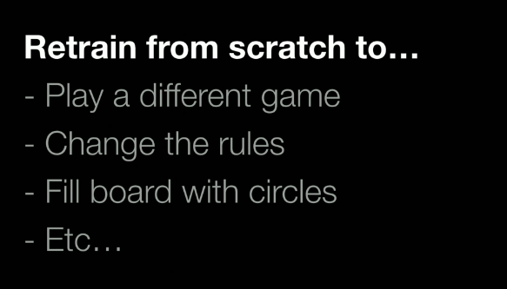

Slide 43
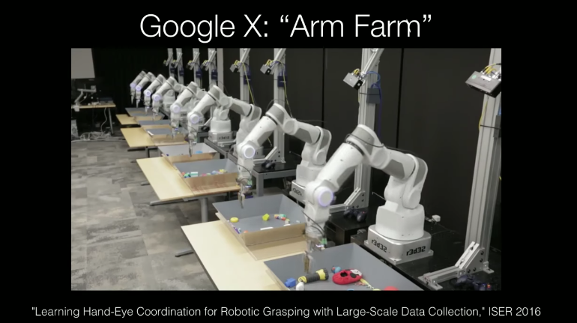

Slide 44
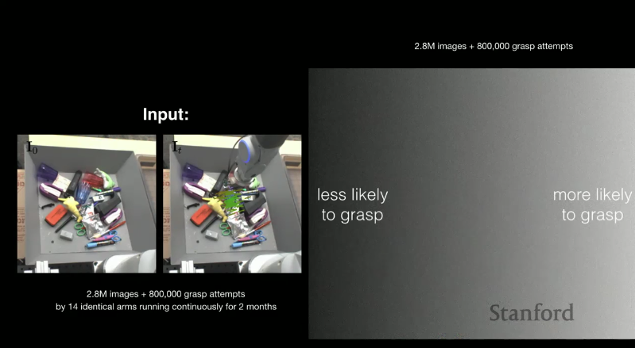

Slide 45
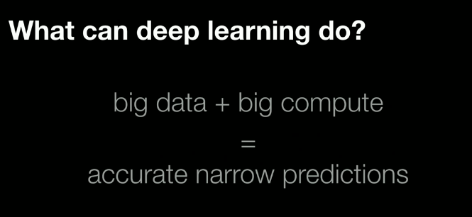

Slide 46
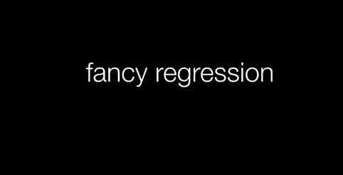

Slide 47
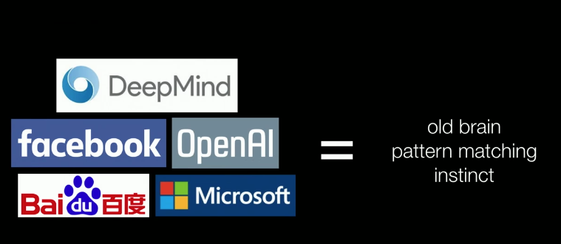

Slide 48
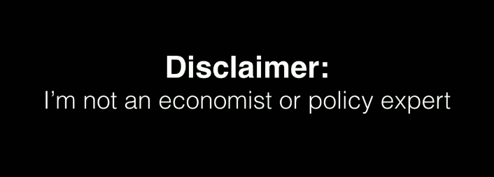

Slide 49
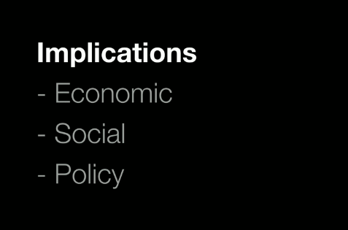

Slide 50


Slide 51


Slide 52


Slide 53

Complements: data & compute

Slide 54


Slide 55


Slide 56

Caputalize on worse human instincts. Most poralized version of our vision of the world
Red feed blue feed

Slide 57


Slide 58


Slide 59

Russia: information campaign at this bubble

Slide 60


Slide 61


Slide 62


Slide 63

Immigrants or soon of immigrants

Slide 64


Slide 65


Slide 66


Slide 67

Wales trained to pick up a trash in their tank and trade them with fish. One day a seagull died and
Fell down into the tank and instead of getting one batch of fish they got 2 (because it was a big object or
Something. Wales did not eat all and kept one batch to capture more seagull.

Slide 68


Slide 69


Slide 70

We still have the old part, but now neo-cortex

Slide 71


Slide 72


Slide 73


Slide 74


Slide 75



Slide 76



Slide 77


11 years ago.
Jetsons controlled by a human
We are a living in a
Jetsons society

Slide 78


Slide 79

33:25

